Slide 1
Evolving the Lead Management Process to be Customer First
Elaine Chum and Paula Rizzini
Marketing & eCommerce ASEAN Pacific
March 2020

Slide 2




Role & Responsibilities defined in Lead Management Process
 | Lead Management Process | Demand Generation/ Campaign | Lead Funnel Manager | Lead Manager | Account Manager | Data Steward
Team | HS Marketing | HS Marketing | HS Marketing | HS Marketing | HS Cluster & Countries’ BMM | Business Transformation
Team Leader | Lian Vergeer-Langens | Lian Vergeer-Langens | Elaine Chum | Paula Rizzini | HS Cluster & CO Leader | Fiona Cheong
Team is Responsible for | Overall LM process owner | Generating demand/ leads | Leads are followed up; Tracking performances against KPIs via DM. | Leads are followed-up; Ensure quality and follow through. | Ensure HS Sales team follow through with assigned validated leads | Manage overall SFDC platform and data integrity.
Team members supporting this | Elaine Chum | Digital: Elaine Chum Events: Ching Wai Yi Marketing: HS Marketing Ops & Marketing | Paula Rizzini (ANZ) Fanny Israr (ID/ MY) Autumn Moon (KR) Vacant TBA (PHI/ PHI) Varitha Santinan (VN/ TH) | Tele-prospecting team (Verticurl, WPP Group) | See XLS file for mapping by clusters, countries and districts. | Mansor Mason
KPI | MQL Growth +5%; MQL > Opportunity Conversion 9% | MQL Growth +5%; MQL > Opportunity Conversion 9% | MQL > Opportunity Conversion 9% | MQL Open 1 day MQL > TQL 2 days MQL > SQL 5 days MQL > Opportunity Conversion 9% | MQL > Opportunity Conversion 9% | Quality (KPI TBD)

Slide 3
Modality team KPIs
Capture
Qualify, Enrich & Distribute
Pursue Lead
Convert Opp
SALES
Step | 0 | 1 | 2 | 3 | 4 | 5
Lead Stage | NA | MQL | TQL & SAL | SQL | Opportunity | OIT
Objective | NA | Validate (Real/ Fake; Intent is right) | Qualify, Validate, Enrich, & Distribute (warm/ hot); Accept. | Contact customer to pursue opportunity. | Create sales opportunity. | Get the SALE!
Who does this? | Prospect/ Customer | Tele-prospector (TP) | TP: Update SFDC | Sales: Review > Call > Update SFDC or TP. TP: Update SFDC | Sales: Action on Opportunity. TP: Update SFDC | Sales: Call TP: Update SFDC
Action | Fill out Contact or Lead form | Check if lead is REAL (hospital/ email/ phone). Intent is relevant to HS/ SRC Biz. | Email/ Call to follow-up with Customer on enquiry. Update SFDC: Enrich & Distribute Lead. | Sales follow-up to further qualify lead with aim to create Opportunity. Update SFDC directly or call TP to update. | Sales identifies opportunity and start preparing for bid/ quote. Update SFDC directly or call TP to update. | Sales closes deal and sign contract with customer.
Lead Status | NA | Open - Marketing | Distributed Accepted – Sales | Converted | Opportunity | Sales Order
When to CLOSE lead? | NA | Fake lead. Wrong intent. | No intent to buy Philips solution. No response from customer after 3x. | Sales lost opp or feels it’s not good lead to pursue (e.g. no budget, prefer competitor). | Lost opportunity. | Lost sales deal.
KPIs |  | 1 day to open and review lead. | 2 days: Review/ follow-up/ distribute / accept/ close. | 5 days: Update SFDC with Opp status. | MQL > Opp Rate.

Slide 4
Verticurl/TP key responsibilities and checklist
Cadence | Task | Who
Daily | Make sure SFDC is updated according to LM process rules; Respond every email within 24h; Call/contact every new TQL within 24h; Report any issue occurred during the day that needs to be solved or can be taken as a lesson for process improvement; | Deborah Mao, ChanJae Park
Weekly | Send a standard report to Paula Rizzini (template to be defined); | Ravi Venkatachalapathy, ChanJae Park
Bi-weekly | Have bi-weekly calls with Paula Rizzini to discuss lead status, challenges and any other relevant topic; | ChanJae Park, Paula Rizzini, Deborah Mao, Ravi Venkatachalapathy
Monthly | Have monthly calls with Paula Rizzini and Elaine Chum to discuss lead status, challenges and any other relevant topic (template to be defined); | Alex Gibson, Elaine Chum, Paula Rizzini, Fiona Cheong and ChanJae Park

Slide 5
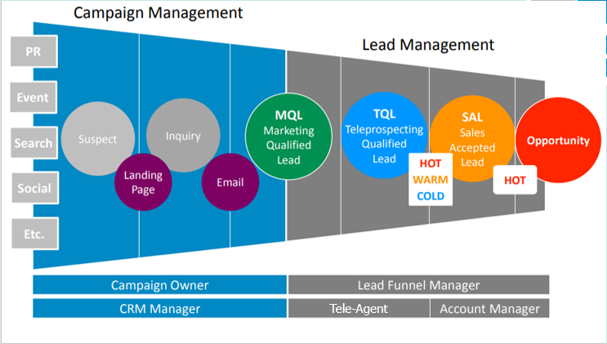
Overview of End-to-End Lead Management process

Slide 6
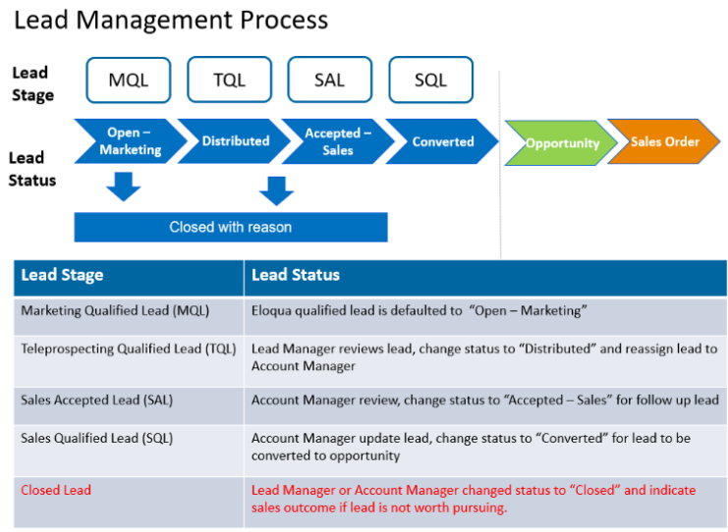
Recap of Lead Management process definitions

Slide 7
Overview of Philips Business and Operations
Healthcare Business/ Solutions
Healthcare Informatics (HI)
Diagnostic Imaging (DI)
Image Guided Therapy (IGT)
Monitoring & Analytics; Therapeutic Care (MATC)
Population Health Management (PHM)
Sleep & Respiratory Care (SRC)
UltraSound (US)
Healthcare Service Solutions
Healthcare Enterprise Solutions
Product Portfolio
All products across all businesses, including SRC
ASEAN Pacific Countries
(Core & Others)
ANZ
ID
KR
MY
PHIL
SG
TH
VN
Other/ Emerging
Brunei, Cambodia, Laos, Myanmar, Pakistan, Australasia
Business Model
Direct - Offline
Direct – Online
(EDI, eShop)
Distributor

Slide 8
Lead Management Standard process

Slide 9
Teleprospecter to play heavier role in qualification, enrichment, follow-up and updating of SFDC in new Lead Management setup
Capture
Qualify, Enrich & Distribute
Pursue Lead
Convert Opp
SALES
Step | 0 | 1 | 2 | 3 | 4 | 5
Lead Stage | NA | MQL | TQL & SAL | SQL | Opportunity | OIT
Objective | NA | Validate (Real/ Fake; Intent is right) | Qualify, Validate, Enrich, & Distribute (warm/ hot); Accept. | Contact customer to pursue opportunity. | Create sales opportunity. | Get the SALE!
Who does this? | Prospect/ Customer | Tele-prospector (TP) | TP: Update SFDC | Sales: Review > Call > Update SFDC or TP. TP: Update SFDC | Sales: Action on Opportunity. TP: Update SFDC | Sales: Call TP: Update SFDC
Action | Fill out Contact or Lead form | Check if lead is REAL (hospital/ email/ phone). Intent is relevant to HS/ SRC Biz. | Email/ Call to follow-up with Customer on enquiry. Update SFDC: Enrich & Distribute Lead. | Sales follow-up to further qualify lead with aim to create Opportunity. Update SFDC directly or call TP to update. | Sales identifies opportunity and start preparing for bid/ quote. Update SFDC directly or call TP to update. | Sales closes deal and sign contract with customer.
Lead Status | NA | Open - Marketing | Distributed Accepted – Sales | Converted | Opportunity | Sales Order
When to CLOSE lead? | NA | Fake lead. Wrong intent. | No intent to buy Philips solution. No response from customer after 3x. | Sales lost opp or feels it’s not good lead to pursue (e.g. no budget, prefer competitor). | Lost opportunity. | Lost sales deal.
KPIs |  | 1 day to open and review lead. | 2 days: Review/ follow-up/ distribute / accept/ close. | 5 days: Update SFDC with Opp status. | MQL > Opp Rate.

Slide 10
HOT & WARM leads will be validated by TP and handed off to Sales to follow through with Prospect/ Customers
Lead Qualification Level | Hot | Warm | Cold | Disqualified
Description | Has potential opportunity with enough information available to distribute lead to Sales. The customer buying intent has been validated. Sales have to decide if they Accept the lead and Convert into an opportunity. | The lead seems interesting, but there is not enough information yet. The lead needs to be nurtured further. | Initial and minimum status of a lead is available. Further information has to be gathered to be able to decide whether this lead is interesting for sales to follow-up | This lead is not yet qualified.
BANT | Meets all BANT criteria Budget Authority Need Timing | 1 or 2 of BANT criteria missing. | 3 or more BANT criteria missing. | Does not meet BANT criteria. Unqualified
Action | Sales to follow through with Lead | TP to follow through to enrich lead with as much information as possible. OR Assign to Sales to follow through if HCP prefers to have Sales call them directly. | TP to follow through to enrich lead with as much information as possible. | Does not come through SFDC. Put contact through to Nurture program – turn the lead into a contact.
Notes:
Budget: What kind of financial possibilities does the lead have?
Authority: Which decision authority does the lead have?
Need: How strong is the interest/ need to buy the Product/ Solution
Timing: In what time frame (months) is the buying intent present?

Slide 11
Escalation Matrix
Query raised
Related to IT –
email access
SFDC issue – access, functionality, report/dashboard
Lead distributed wrongly
Issue with AM/Distributor
Customer product complain – for existing customers
General complain
Open IT ticket and cc Paula Rizzini
Contact
Paula Rizzini
Contact
Paula Rizzini
Contact
Paula Rizzini
Send to CS team
Contact
Paula Rizzini
Level 1
Contact Paula Rizzini
Contact Fiona Cheong
Contact Fiona Cheong
Contact Sales District Leader
Contact
Paula Rizzini
Level 2
Contact Christopher Farmer
Contact Country Cluster Lead
Contact
Elaine Chum
Level 3
Verticurl level | First POC for issue, problem should be solved within three days; to escalate only if problem isn’t solved and there’s no justification for this;
 | Second POC for issue, problem should be solved in max one week; to escalate only if problem isn’t solved and there’s no justification for this;
 | Third POC for issue

Slide 12
Cluster Country BMM

Slide 13
Lead Management process
Capture
Qualify, Enrich & Distribute
Pursue Lead
Convert Opp
SALES
Step | 0 | 1 | 2 | 3 | 4 | 5
Lead Stage | NA | MQL | WIP | TQL | Opportunity | OIT
Objective | NA | Validate (Real/ Fake; Intent is right) | Qualify, Validate, Enrich, & Distribute (warm/ hot); Accept. | Contact customer to pursue opportunity. | Create sales opportunity. | Get the SALE!
Who does this? | Prospect/ Customer | Tele-prospector (TP) | TP: Update SFDC | Sales: Review > Call > Update SFDC or TP. TP: Update SFDC | Sales: Action on Opportunity. TP: Update SFDC | Sales: Call TP: Update SFDC
Action | Fill out Contact or Lead form | Check if lead is REAL (hospital/ email/ phone). Intent is relevant to HS/ SRC Biz. | Email/ Call to follow-up with Customer on enquiry. Update SFDC: Enrich & Distribute Lead. | Sales follow-up to further qualify lead with aim to create Opportunity. Update SFDC directly or call TP to update. | Sales identifies opportunity and start preparing for bid/ quote. Update SFDC directly or call TP to update. | Sales closes deal and sign contract with customer.
Lead Status | NA | Open - Marketing | Distributed Accepted – Sales | Converted | Opportunity | Sales Order
When to CLOSE lead? | NA | Fake lead. Wrong intent. | No intent to buy Philips solution. No response from customer after 3x. | Sales lost opp or feels it’s not good lead to pursue (e.g. no budget, prefer competitor). | Lost opportunity. | Lost sales deal.
KPIs |  | 1 day to open and review lead. | 1-7 days: Review/ follow-up/ distribute / accept/ close. | 23 days: Update SFDC with Opp status. MQL > Opp Rate.

Slide 14
Stage MQL – scenarios Objectives: Validate (Real/ Fake; Intent is right)
Qualify, Enrich
MQL Scenarios | Action
Company Service provider offer / Student research / partnership / jobs / conferences | Tele-agent closes lead in SFDC (Philips no interest)
Lead enquires is related to other areas outside of Health System (Personal Health & Lighting) | Tele-Agent closes lead in SFDC and sends lead contact details and enquire to Paula Rizzini
Lead provided wrong contact details | Tele-Agent Googles lead’s name to find a way to contact this person. If not possible, TA to close lead
Lead enquires brochure/lectures | See slide #21 for whole process
Duplicated Lead – when one lead has different requests, multiple accounts are created | To close one of the accounts – copy info from the closed account and add to the valid one
Complaint/Service request | Related to customer service complaint or request (email to Service team outside SFDC) and close the lead
Lead assigned to wrong country / wrong modality | Email Paula Rizzini – Paula to reach out to Digital Services
Note: Tele-agent must input all the touch points information (effective or not) into SFDC

Slide 15
Lead Management process
Capture
Qualify, Enrich & Distribute
Pursue Lead
Convert Opp
SALES
Step | 0 | 1 | 2 | 3 | 4 | 5
Lead Stage | NA | MQL | WIP | TQL | Opportunity | OIT
Objective | NA | Validate (Real/ Fake; Intent is right) | Qualify, Validate, Enrich, & Distribute (warm/ hot); Accept. | Contact customer to pursue opportunity. | Create sales opportunity. | Get the SALE!
Who does this? | Prospect/ Customer | Tele-prospector (TP) | TP: Update SFDC | Sales: Review > Call > Update SFDC or TP. TP: Update SFDC | Sales: Action on Opportunity. TP: Update SFDC | Sales: Call TP: Update SFDC
Action | Fill out Contact or Lead form | Check if lead is REAL (hospital/ email/ phone). Intent is relevant to HS/ SRC Biz. | Email/ Call to follow-up with Customer on enquiry. Update SFDC: Enrich & Distribute Lead. | Sales follow-up to further qualify lead with aim to create Opportunity. Update SFDC directly or call TP to update. | Sales identifies opportunity and start preparing for bid/ quote. Update SFDC directly or call TP to update. | Sales closes deal and sign contract with customer.
Lead Status | NA | Open - Marketing | Distributed Accepted – Sales | Converted | Opportunity | Sales Order
When to CLOSE lead? | NA | Fake lead. Wrong intent. | No intent to buy Philips solution. No response from customer after 3x. | Sales lost opp or feels it’s not good lead to pursue (e.g. no budget, prefer competitor). | Lost opportunity. | Lost sales deal.
KPIs |  | 1 day to open and review lead. | 1-7 days: Review/ follow-up/ distribute / accept/ close. | 23 days: Update SFDC with Opp status. MQL > Opp Rate.

Slide 16
Flows to be followed based on customer information provided/request
Lead form
When lead has enough information and ready to be assigned
Request: product information / talk to sales team
Scenario #0
Lead quality isn't good – TA to get more info (WIP)
Scenario #1

Slide 17
Stage TQL & SAL Objective: Qualify, Validate, Enrich
Qualify, Enrich
Scenario #0
Day 1
Day 2
Day 3
Day 4,5,6
Day 7
Teleprospecter (TP)
TP emails customer – cc Paula and the account manager
Prospect/Customer
Email 0 – Thank you for contacting Philips
Note: Tele-agent must input all the touch points information (effective or not) into SFDC

Slide 18
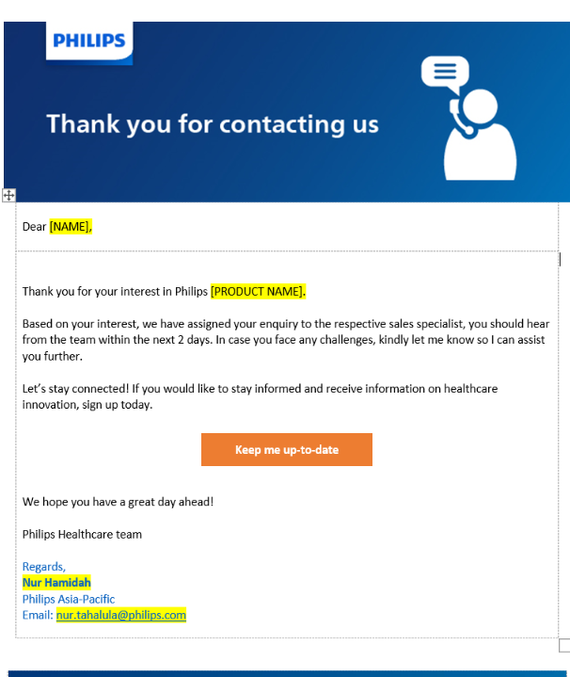
Email 0
Thank you for contacting Philips + next steps
Dear [NAME],
Thank you for your interest in Philips [PRODUCT NAME]. Based on your interest, we have assigned your enquiry to the respective sales specialist, you should hear from the team within the next 2 days. In case you face any challenges, kindly let me know so I can assist you further. Let’s stay connected! If you would like to stay informed and receive information on healthcare innovation, sign up today. Keep me up-to-date We hope you have a great day ahead! Philips Healthcare team Regards, Nur Hamidah Philips Asia-Pacific Email: nur.tahalula@philips.com

Slide 19
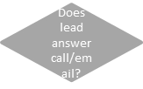
Stage TQL & SAL Objective: Qualify, Validate, Enrich
Qualify, Enrich
Scenario #1
Day 1
Day 2
Day 3
Day 4,5,6
Day 7
Next steps email – email #0
TP to send email 1 to lead and follow standard LM process
Yes
Teleprospecter (TP) transfers lead (TQL & SAL)
TP calls lead
(1st attempt)
Does lead answer call?
Prospect/Customer
Yes
Yes
Yes
Yes
No
Does lead answer call/email?
TP calls lead
(2nd attempt)
Does lead answer call/email?
TP calls lead
(3rd attempt)
TP to send
email 2
No
No
No
Yes
Outbound Telemarketing Script – Qualification brief
Email 1 – Thank you for contacting Philips
Email 2 – Sorry we missed you
Email 3 – Last email before closing lead
No
No
Does lead answer email/call?
TP to send email 3 and closes lead
Wait for 1 day
Wait for 3 days
Note: Tele-agent must input all the touch points information (effective or not) into SFDC

Slide 20
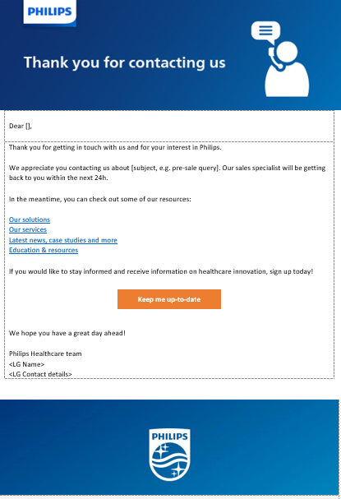
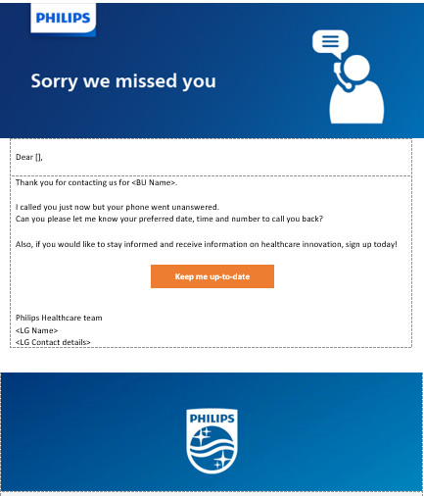
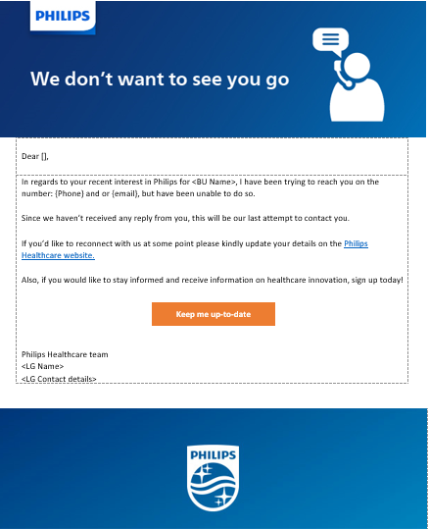
Stage TQL & SAL Communication script/template/text
Qualify, Enrich
Scenario #1
Email 0
Thank you for contacting Philips
Email 1.a
Thank you for contacting Philips
Email 2.a
Sorry we missed you
Email 3.a
Last email before closing lead

Slide 21
Stage TQL & SAL – Objective: Distribute (warm/ hot); Accept
Distribute
Such leads are assigned to respective business group based on Lead Matrix and criteria like:
State
Modality / sub modality
Product
Example of lead matrix
Cluster | Connected Care (CC)
Business | Monitoring & Analytics; Therapeutic Care (MATC)
District | General queries | Emergency Care, Resuscitation & Cardiology | Hospital Repiratory | General Care | Medical Consumable and Sensors | Fetal | Patient Monitoring
General queries |  | David Cashion | Traci Wellington | Libby Simpson | Tom Clarke | Libby Simpson | Tom Clarke
NZ | Angus Brown | Kevin Robinson(N)/Ally Hanson(S) | Kevin Robinson(N)/Ally Hanson(S) | Kevin Robinson(N)/Ally Hanson(S) | Kevin Robinson(N)/Ally Hanson(S) | Kevin Robinson(N)/Ally Hanson(S) | Kevin Robinson(N)/Ally Hanson(S)
NSW/ACT | Sarah Pinchbeck | Lee Hudson | Elle Reichel(N)/Melissia Hyson(S) | Lee Hudson | Lee hudson | Stuart Wright (Samden) | Elle Reichel(N)/Melissia Hyson(S)
QLD/NT | Andreas(Andy) Roost | Gemma Cooper (hospital only) | Ann Beckett (S) Craig Hornsby (N) | Gemma Cooper (hospital only) | Gemma Cooper (hospital only) | Gemma Cooper (hospital only) | Ann Beckett (S) Craig Hornsby (N)
VIC | Chantal Guziak | Allen O'Connell | Louise Capp(E) / Lexie Sutton(W) | Allen O'Connell | Allen O'Connell | Allen O'Connell | Louise Capp(E) / Lexie Sutton(W)
SA | Chantal Guziak | Allen O'Connell | Ray Main | Allen O'Connell | Allen O'Connell | Allen O'Connell | Ray Main
TAS | Chantal Guziak | Allen O'Connell | Louise Capp | Allen O'Connell | Allen O'Connell | Allen O'Connell | Louise Capp
WA | Bruce Dwyer | Allen O'Connell | Linda Barnes | Allen O'Connell | Allen O'Connell | Allen O'Connell | Linda Barnes
Products
 |  | Defibrillators | V60 | VS monitors | Paper |  | MX800, MX450, MX500
 |  | FR3 | V680 | IntelliVue MP5SC | Ultrasound Gel |  | MMX, X3, MX750, MX850
 |  | Heartstart - HS1 | Hospitial Masks & Circuits | Efficia | ECG dots | FM Monitor range
 |  | ECG | Mask for Ventilation | Vital - MediMac | Lead cables | Intelispace Perinatal
 |  | AED |  | Roll Stands
 |  | FRX |  | Baskets
 |  | TC50 Cardiograph |  | Guardian Solutions - IGS
 |  | TC70 Cardiographs |  | Holter - Inmed (Kishore National)
 |  |  |  | Stress testing - Inmed Steve McDowell

Slide 22
Lead Management process
Capture
Qualify, Enrich & Distribute
Pursue Lead
Convert Opp
SALES
Step | 0 | 1 | 2 | 3 | 4 | 5
Lead Stage | NA | MQL | TQL & SAL | SQL | Opportunity | OIT
Objective | NA | Validate (Real/ Fake; Intent is right) | Qualify, Validate, Enrich, & Distribute (warm/ hot); Accept. | Contact customer to pursue opportunity. | Create sales opportunity. | Get the SALE!
Who does this? | Prospect/ Customer | Tele-prospector (TP) | TP: Update SFDC | Sales: Review > Call > Update SFDC or TP. TP: Update SFDC | Sales: Action on Opportunity. TP: Update SFDC | Sales: Call TP: Update SFDC
Action | Fill out Contact or Lead form | Check if lead is REAL (hospital/ email/ phone). Intent is relevant to HS/ SRC Biz. | Email/ Call to follow-up with Customer on enquiry. Update SFDC: Enrich & Distribute Lead. | Sales follow-up to further qualify lead with aim to create Opportunity. Update SFDC directly or call TP to update. | Sales identifies opportunity and start preparing for bid/ quote. Update SFDC directly or call TP to update. | Sales closes deal and sign contract with customer.
Lead Status | NA | Open - Marketing | Distributed Accepted – Sales | Converted | Opportunity | Sales Order
When to CLOSE lead? | NA | Fake lead. Wrong intent. | No intent to buy Philips solution. No response from customer after 3x. | Sales lost opp or feels it’s not good lead to pursue (e.g. no budget, prefer competitor). | Lost opportunity. | Lost sales deal.
KPIs |  | 1 day to open and review lead. | 2 days: Review/ follow-up/ distribute / accept/ close. | 5 days: Update SFDC with Opp status. | MQL > Opp Rate.

Slide 23
Stage SQL - scenarios Objective: Pursue Lead
Pursue Lead, Convert Opp, SALES
Stage | SQL Scenarios | Action
SQL | Lead is distributed to AM but AM doesn’t update SFDC with Opp. status in the following 5 days | TP sends an email reminder to AM; AM has max. 2 days to update lead status into Opportunity or Closed lead; If update isn’t done during the period of max. 7 days (without a justification), Paula Rizzini to escalate to Business Manager;
Opportunity | When lead is converted into Opp. | TP to keep track of opportunities and make sure SFDC is updated regularly in this stage; Once lead is converted into Opportunity, TP to set monthly email reminders for AM of open Opportunity in SFDC until lead is closed;

Slide 24
Cluster Channel Partner

Slide 25
Lead Management process
Indirect sales apply for MATC and SRC modalities only.
For leads that need to be transferred to distributors, the steps are similar to the standard LM process. What will differ is the timeline & lead distribution – in some cases, leads will be distributed to an AM Philips employee and this person will distribute the leads to third parties and in other cases, TP will transfer lead directly to a Philips distributor.
Capture
Qualify, Enrich & Distribute
Pursue Lead
Convert Opp
SALES
Step | 0 | 1 | 2 | 3 | 4 | 5
Lead Stage | NA | MQL | TQL & SAL | SQL | Opportunity | OIT
Objective | NA | Validate (Real/ Fake; Intent is right) | Qualify, Validate, Enrich, & Distribute (warm/ hot); Accept. | Contact customer to pursue opportunity. | Create sales opportunity. | Get the SALE!
Who does this? | Prospect/ Customer | Tele-prospecter (TP) | TP: Update SFDC | Sales/distributor: Review > Call > Update SFDC or TP. TP: Update SFDC | Sales/distributor: Action on Opportunity. TP: Update SFDC | Sales/distributor: Call TP: Update SFDC
Action | Fill out Contact or Lead form | Check if lead is REAL (hospital/ email/ phone). Intent is relevant to HS/ SRC Biz. | Email/ Call to follow-up with Customer on enquiry. Update SFDC: Enrich & Distribute Lead. | Sales follow-up to further qualify lead with aim to create Opportunity. Update SFDC directly or call TP to update. | Sales identifies opportunity and start preparing for bid/ quote. Update SFDC directly or call TP to update. | Sales closes deal and sign contract with customer.
Lead Status | NA | Open - Marketing | Distributed Accepted – Sales | Converted | Opportunity | Sales Order
When to CLOSE lead? | NA | Fake lead. Wrong intent. | No intent to buy Philips solution. No response from customer after 3x. | Sales lost opp or feels it’s not good lead to pursue (e.g. no budget, prefer competitor). | Lost opportunity. | Lost sales deal.
KPIs |  | 1 day to open and review lead. | 2 days: Review/ follow-up/ distribute / accept/ close. | 2 weeks: Update SFDC with Opp status. | MQL > Opp Rate.

Slide 26
MATC - Lead assignment to distributors
AED Pre-hospital enquires: it will be assigned to Lyn Donavan (AM Philips) and Lyn will distribute the leads to third parties and cc TP agent.
MRI Monitoring and Stress Holter Cardiac: TP can distribute leads straight to distributors and cc Lyn Donavan to emails.
District | AED Pre-Hospital (Schools, gym, etc) | MRI Monitoring | Stress and Holter Cardiac
Philips ANZ | Lyn.Donovan@philips.com
Distributor ANZ |  | Imaging Solutions | Inmed
 |  | g.honey@imagingsol.com.au> | Lana Parbery - lana.parbery@inmed.com.au
 |  | b.honey@imagingsol.com.au | Steve McDowell - steve.mcdowell@inmed.com.au
Products
 | HearStart HS1 | V53 | U25
 | HeartStart FRx |  | T86
Further Directions
Lead distribution | TP to send list of enquires to Lyn Donavan -> Lyn to distribute leads to distributors with TP cc'd in the email for follow up | TP to distribute lead to both emails above and cc Lyn Donovan to email | TP to distribute lead to both emails above and cc Lyn Donovan to email
Follow up/SFDC Update | Lyn Donavan is responsible for getting information about lead status from distributor. | TP is responsible for getting lead status update from distributor. | TP is responsible for getting lead status update from distributor.
KPI | The period to have SFDC updated is 2 weeks instead of 5 days. If update doesn’t happen in estimated period of time, TP to follow escalation matrix rules. | The period to have SFDC updated is 2 weeks instead of 5 days. If update doesn’t happen in estimated period of time, TP to follow escalation matrix rules. | The period to have SFDC updated is 2 weeks instead of 5 days. If update doesn’t happen in estimated period of time, TP to follow escalation matrix rules.

Slide 27
SRC - Lead assignment to distributors
Please use SRC spreadsheet to access full list of products
District | Reseller Channel | Pharmacy Sleep Services Channel
AU | James Ponder - Reseller Channel Leader | Penny Backhouse - PSS Marketing Manager
NZ | Michele Norton
NSW | Caroline Bowie
QLD | Liam Baker (Also responsible for Actigraphy leads in ANZ)
VIC | Piri Edwards
SA/NT | Michele Norton
WA | David Lynch
Products | Reseller Channel | Pharmacy Sleep Services Channel
 | Sleep - CPAP Devices & Accessories | Masks & Accessories DreamStation Auto CPAP DreamStation CPAP Pro DreamStation Go Accessories DreamWear Full Face DreamWear Under the Nose DreamWear Gel Pillow DreamWisp Pico Nuance Wisp Amara View Amara Gel Mask TrueBlue EasyLife Nasal ComfortGel Blue Profile Lite Fitlife Chin Straps | Sleep - CPAP Devices & Accessories | Masks & Accessories DreamStation Auto CPAP DreamStation CPAP Pro DreamStation Go Accessories DreamWear Full Face DreamWear Under the Nose DreamWear Gel Pillow DreamWisp Pico Nuance Wisp Amara View Amara Gel Mask TrueBlue EasyLife Nasal ComfortGel Blue Profile Lite Fitlife Chin Straps
Further Directions
Lead distribution | TP to send list of enquires to respective Philips AM, AM to distribute leads to distributors with TP cc'd in the email for follow up. For Reseller Channel only, always cc James Ponder in the emails. | TP to send list of enquires to respective Philips AM, AM to distribute leads to distributors with TP cc'd in the email for follow up.
Follow up/SFDC Update | AM is responsible for getting information about lead status from distributor and send to TP to update SFDC. | AM is responsible for getting information about lead status from distributor and send to TP to update SFDC.
KPI | The period to have SFDC updated is 2 weeks instead of 5 days. If update doesn’t happen in estimated period of time, TP to follow escalation matrix rules. | The period to have SFDC updated is 2 weeks instead of 5 days. If update doesn’t happen in estimated period of time, TP to follow escalation matrix rules.

Slide 28
Stage SQL - scenarios Objective: Pursue Lead
Pursue Lead, Convert Opp, SALES
Stage | SQL Scenarios | Action
SQL | Lead is distributed to AM or distributor but AM/distributor don’t update TP with Opp. status in the following 2 weeks | TP emails a list of lead IDs to AM/distributor as a reminder If none of the parties reply TP in 48h, TP to call AM/distributor to run through the list and make the update over a call. Note: Purchase cycle for both modalities is shorter - TP should aim to update SFDC from SQL to sales directly. If either AM/Distributor don’t contribute with providing information, TP to escalate issue to Paula Rizzini to escalate to Business Manager.
Opportunity | When lead is converted to Opp. | TP to keep track of opportunities and make sure SFDC is updated regularly in this stage; Once lead is converted into Opportunity, TP to set monthly email reminders for AM of open Opportunity in SFDC until lead is closed;

Slide 29
Planning and checklist for new process deployment

Slide 30
Proposed Timelines
 | 16-Dec to 6-Jan | 13-Jan | Feb | 2-Mar | 9-Mar | 16-Mar | 23-Mar | 30-Mar | 6-Apr | 13-Apr | 20-Apr | 27-Apr | 4-May
Discovery
Kick-off
Planning & Alignment |  |  | Re-planning | Modelling | Model alignment with MT
Go/ No-Go |  |  |  |  |  | GO/ NO-GO
Implementation |  |  |  |  |  |  | Agency training + scripting | Agency training + scripting | UAT & Go Live Check
Review & Optimize |  |  |  |  |  |  |  |  |  | Check-in | Check-in | Check-in | Check-in
Aim to go live mid Apr 2020.
Bi-weekly review/ optimization cadence within the initial 2 months; Monthly cadence from the 3rd month of go live.
Pilot phase to run till 31-Jul with aim to continue and scale to other business and countries from 30-Jun 2020.

Slide 31
Checklist for new LM process deployment
Action Checklist | Action Owner | Planned | Re-planned | Status
Mapping evolved LM process | Elaine C | 13-Mar | - | Completed
Modality role/ name mapping x-cluster & x-country | Paula R | Collating & validating | - | Completed
ANZ Marketing Committee Team sharing | Elaine C | 19-Mar | - | Completed
Creation of Lead Management SoP and Escalation Matrix | Paula R. | 20-Mar | - | SoP finalisation is late. SoP proposal was sent by Paula to Verticurl on 21/03 and the team hasn't come back to Philips yet with feedback. Email and calls were done from Paula' side but the team hasn't provided it yet
SFDC Access & Training to Tele-prospecting team | Paula R., Fiona C. | 26-Mar | 30-Mar | Completed
Modality business and product training to Tele-prospecting team | Paula R. | -
Connected Care: MATC |  | MATC: 30-Mar | 7-Apr | Training was rescheduled since MATC team wasn't able to provide sales training material and attend the training session.
Connected Care: Sleep & Respiratory Care (SRC) |  | SRC: 20-Mar | - | Completed
Precision Diagnostic: Ultrasound (US) |  | US: 24-Mar | - | Completed
Script development & sign off | Paula R., Verticurl | -
Connected Care: MATC | CC – Nic Schneider | MATC: 6-Apr | - | Open
Connected Care: Sleep & Respiratory Care (SRC) | US – Rob Petersen + Team | SRC: 27-Mar | 31-Mar | Verticurl can only provide script proposal by 31st March
Precision Diagnostic: Ultrasound (US) | SRC – Grace Goh + Team | US: 30-Mar | 31-Mar | Verticurl can only provide script proposal by 31st March
UAT, BIU validation and Training | Paula R., Fiona C. | -
Connected Care: MATC | CC – Nic Schneider | MATC: 7-Apr | 6-Apr | Suggest to have one session only with the three groups
Connected Care: Sleep & Respiratory Care (SRC) | US – Rob Petersen + Team | SRC: 30-Mar
Precision Diagnostic: Ultrasound (US) | SRC – Grace Goh + Team | US: 31-Mar
Deployment announcement | Elaine C, Paula R. | 9-Apr |  | Open
Daily Management setup | Elaine C, Paula R. | 15-Apr |  | Open

Slide 33
Stage TQL & SAL Communication script/template/text
Qualify, Enrich
Scenario #1
Email 1.a
Thank you for contacting Philips
Email 2.a
Sorry we missed you
Email 3.a
Last email before closing lead
Subject Line: Attn: {First Name} {Last Name} – Thank you for connecting with Philips
Dear [name],
Thank you for connecting with us and for your interest in Philips.
We appreciate you contacting us about [PRODUCT NAME]. Our [MODALITY NAME] Account Manager will be reaching out to you to provide further information about your enquire.
In the meantime, you can explore some of our resources:
Our solutions
Our services
Latest News, case studies and more
Education & Resources
We hope you have a great day ahead!
Your Philips Healthcare team,
Deborah Mao
Philips Australia and New Zealand
Email: v-partner.deborah_mao@philips.com
Subject Line: Attn: {First Name} {Last Name} – Tried to contact you regarding Philips <BU Name>
Hello <contact name>,
Thank you for contacting Philips for <BU Name>.
I called you just now but your phone went unanswered.
Can you please let me know your preferred date, time and number to call you back?
Philips Healthcare team
<LG Name>
<LG Contact details>
Subject Line: Attn: {First Name} {Last Name} – Tried to contact you regarding Philips <BU Name>
Hi {First Name},
In regard to your recent interest in Philips for <BU Name>, I have been trying to reach you on the number: {Phone} and or {email}, but have been unable to do so.
Since we haven’t received any reply from you, this will be our last attempt to contact you.
If you’d like to reconnect with us at some point please kindly update your details on the Philips Healthcare Website.
Philips Healthcare team
<LG Name>
<LG Contact details>

Slide 34
Stage TQL & SAL Objective: Qualify, Validate, Enrich
Qualify, Enrich
Scenario #2
Day 1
Day 2 & 3
Day 4
Day 5,6,7
Day 8
TP to send email 1 to lead and follow standard LM process
Yes
Teleprospecter (TP) transfers lead (TQL & SAL)
TP emails lead – Email 1.b
Does lead replies email?
Yes
Prospect/Customer
TP to send email 3 and close lead
TP emails lead (2nd attempt)
Does lead replies email?
No
No
Email 1.b – Thank you for contacting Philips + best way to contact a lead
Email 2.b – Reminder to contact Philips
Email 3.b - Last email before closing lead
Wait for 2 days
Wait for 3 days
Note: Tele-agent must input all the touch points information (effective or not) into SFDC

Slide 35
Stage TQL & SAL Communication script/template/text
Qualify, Enrich
Scenario #2
Email 2.b
Reminder to answer
Email 3.c
Last email before closing lead
Email 1.b
Thank you for contacting Philips + best time to talk
Subject Line: Attn: {First Name} {Last Name} – Thank you for connecting with Philips
Dear {NAME},
Thank you for connecting with us and for your interest in Philips. We appreciate you contacting us about [subject, e.g. pre-sale query].
For us to understand your enquire and needs better, could you please provide the best way to contact you as well as day and time?
We hope to hear from you soon.
Philips Healthcare team
<LG Name>
<LG Contact details>
Subject Line: Attn: {First Name} {Last Name} – Thank you for connecting with Philips – follow up email
Hi {First Name},
Thanks for your recent interest in Philips for <BU Name>.
Considering your busy schedule, we are sending this email as a gentle reminder to my previous mail. Only with your response, we are able to provide you a timely and qualitative solution.
Please let us know if there’s an alternate contact number or a convenient time to call you to further assist you.
Philips Healthcare team
<LG Name>
<LG Contact details>
Subject Line: Attn: {First Name} {Last Name} – Tried to contact you regarding Philips <BU Name>
Hi {First Name},
In regard to your recent interest in Philips for <BU Name>, I have been trying to reach you on the number: {Phone} and or {email}, but have been unable to do so.
Since we haven’t received any reply from you, this will be our last attempt to contact you.
If you’d like to reconnect with us at some point please kindly update your details on the Philips Healthcare
Website.
Philips Healthcare team
<LG Name>
<LG Contact details>

Slide 36
Stage TQL & SAL Objective: Qualify, Validate, Enrich
Qualify, Enrich
Scenario #3
Day 1
Day 2,3,4,5,6
Day 7
Day 8,9,10,11
Day 12
TP to send email 1 to lead and follow standard LM process
Yes
Teleprospecter (TP) transfers lead (TQL & SAL)
TP emails lead –
Email 1.c
Does lead replies email?
Yes
Prospect/Customer
TP to send email 3 and close lead
No
TP sends follow up email or call
Does lead replies email?
No
Outbound Telemarketing Script – Qualification brief
Email 1.c – Thank you for contacting Philips + send attachment
Email 2.c – Do you have any questions/are ready to talk?
Email 3.c – Last email before closing lead
Wait for 5 days
Wait for 5 days
Note: Tele-agent must input all the touch points information (effective or not) into SFDC

Slide 37
Stage TQL & SAL Communication script/template/text
Qualify, Enrich
Scenario #3
Email 2.c
Do you have any questions/are ready to talk?
Email 3.c
Last email before closing lead
Email 1.c
Thank you for contacting Philips + send attachment
Subject Line: Attn: {First Name} {Last Name} – Thank you for connecting with Philips
Dear {NAME},
Thank you for connecting with us and for your interest in Philips. We appreciate you contacting us about [subject, e.g. pre-sale query].
As requested, please find attached the brochure [NAME]. Please let me know if you have any questions and if I can assist you further.
Philips Healthcare team
<LG Name>
<LG Contact details>
Subject Line: Attn: {First Name} {Last Name} – Thank you for connecting with Philips – follow up
Dear {NAME},
Thanks for your recent interest in Philips for <BU Name>.
I am reaching out to you to check if you have any questions about the brochure [NAME] or any other Philips solution.
Please do not hesitate to contact us in case you or your team members need more information.
Philips Healthcare team
<LG Name>
<LG Contact details>
Subject Line: Attn: {First Name} {Last Name} – Tried to contact you regarding Philips <BU Name>
Hi {First Name},
In regard to your recent interest in Philips for <BU Name>, since there was no answer from you in the past few days I consider you don’t need my support at this moment.
If you’d like to reconnect with us at some point please kindly update your details on the Philips Healthcare
Website.
Philips Healthcare team
<LG Name>
<LG Contact details>

